Slide 1
User Retention

Slide 2
The problems
Most marketers and product managers only care about growth
Companies capture an email and stop there.
Focus too much on lead magnets and opt-ins
Companies aren’t speaking with their customers
Companies aren’t listening to their customers
Startups aren’t building a product that people love
Loyal customers don’t come overnight, it takes time and a lot of tweaking

Slide 3
Why User Retention?
According to a research report by HBR, “increasing customer retention rates by 5% increases profits by 25% to 95%”.
It cost a lot more to acquire a new customer than it does to retain one.
A happy customer is more likely to stick around longer and that also means that they’re going to be spending more money with you.
A retained happy customer is more likely to refer you to their friends and co-workers, which lowers your cost of growth.
A good user retention rate will also mean that your customer life time value will be much higher as well.
Your company’s overall profit and revenue will be increased due to a good user retention rate.

Slide 4
Listening to your customers
Listening to your customers is a requirement for building the ultimate product.
Examples:
Lacey Baier’s food blog “A Sweet Pea Chef”
Neil Patel , Quicksprouts
Two ways of surveying
Traditional survey
1 click survey

Slide 5
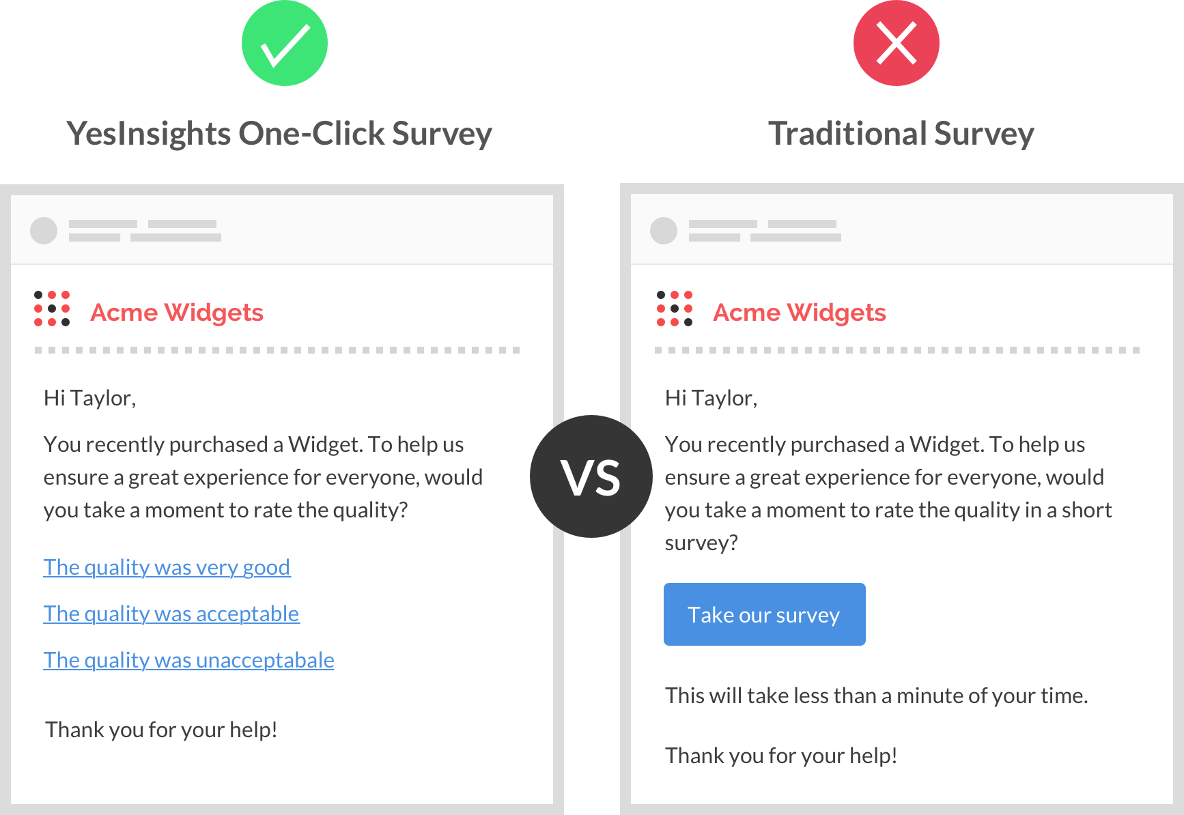

Slide 6
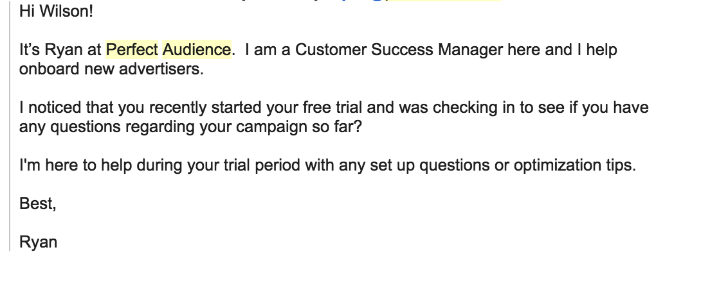
Engaging with your users
Chat with your users often
It’s important to check in with your customers throughout their lifecycle. You want to see if they are experiencing any roadblocks or if they are running into any feature that they don’t know how to use.

Slide 7
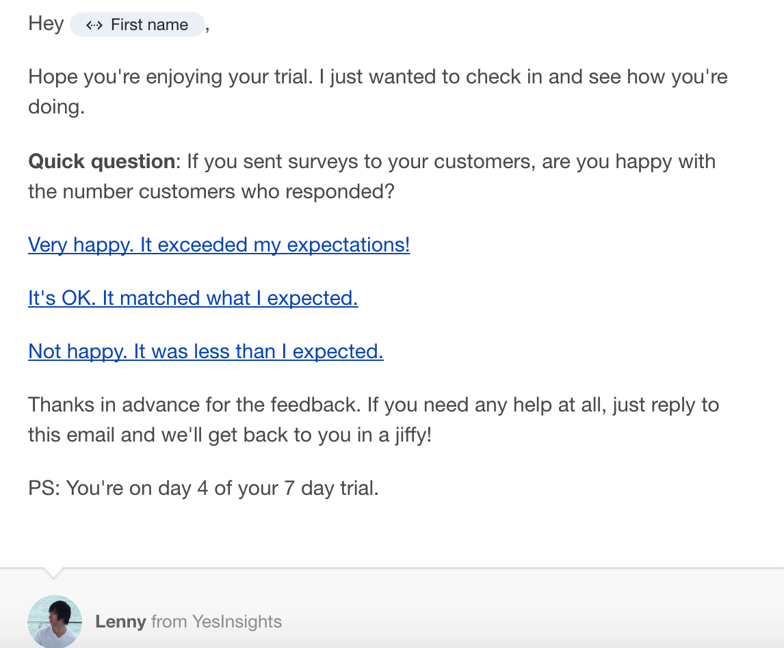
Ask Questions
Checking in like how Ryan is doing it works, but sometime you still won’t receive a response. To achieve the best results, you should add a combination of things and that includes asking questions.
3 goals:
1. Generate a conversation
2. Actionable feedbacks
3. Remind the user

Slide 8
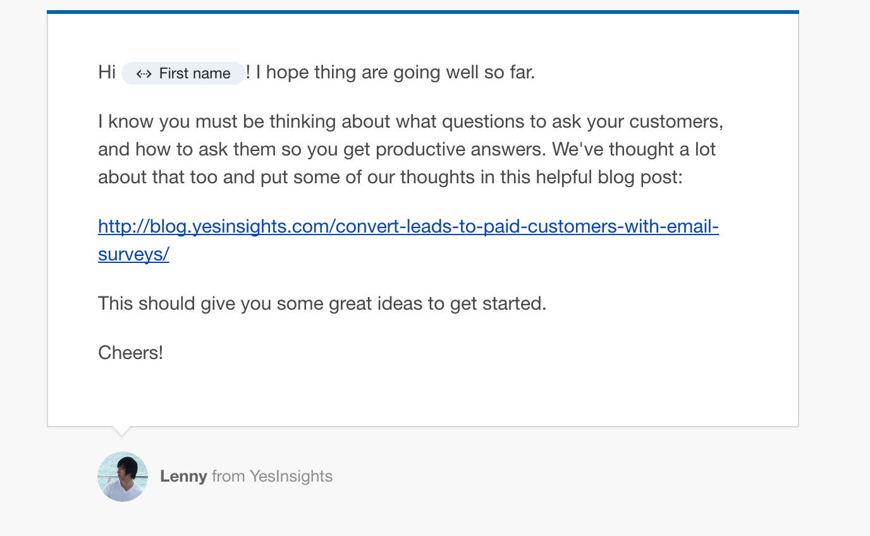
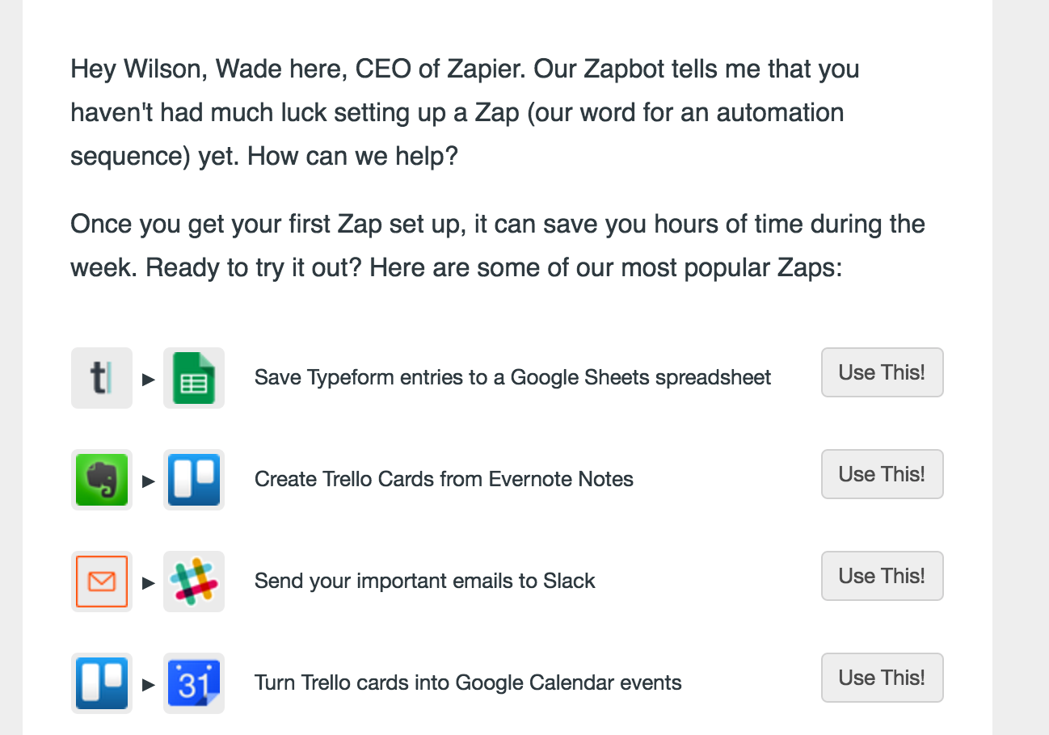
Provide more educational materials

Slide 9
Announce new feature updates
Users don’t notice when your product development slows down. However, if things go quiet for long enough, they’ll be easily distracted when a competitor releases a new feature, whether valuable or frivolous.
Blog
Email newsletter
Slack
Community outreach
Email outreach to existing customers to surprise them.

Slide 10
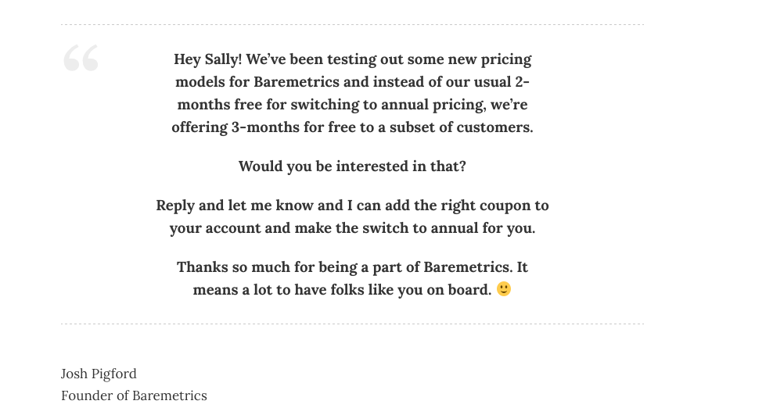
Offering discount/referral codes and giveaways
$14,000 in extra revenue plus an upsell.

Slide 11
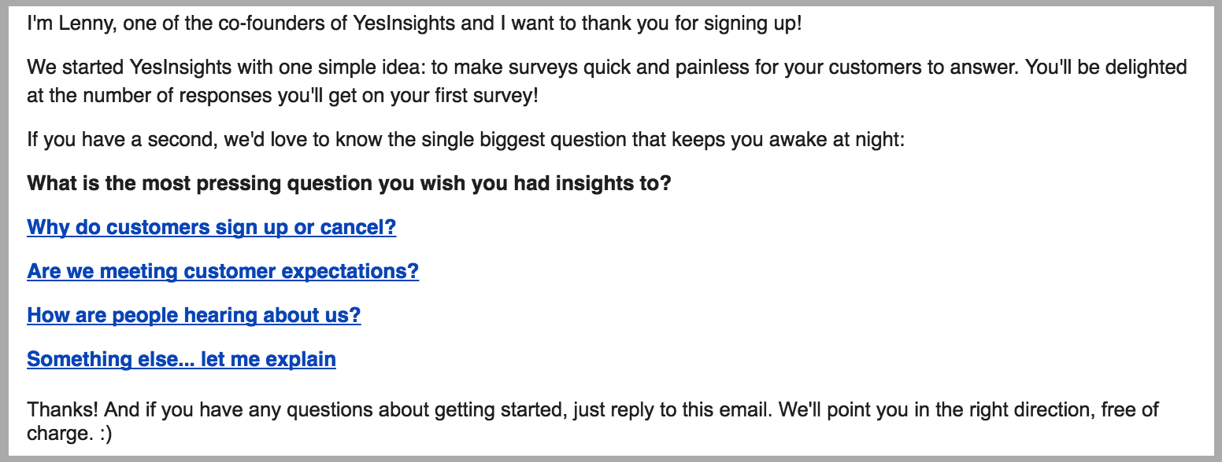
Make a killer first impression
Explain how your app works or the story behind your idea.
Provide them with resources on how to get started.
Let them know that you’re here to help and that they can reach out anytime if they ever need help.
Engage in an early conversion or send a warm greeting.

